Slide 1
Brute Force Algorithms

Slide 2

The Travelling Salesman Problem

Slide 3
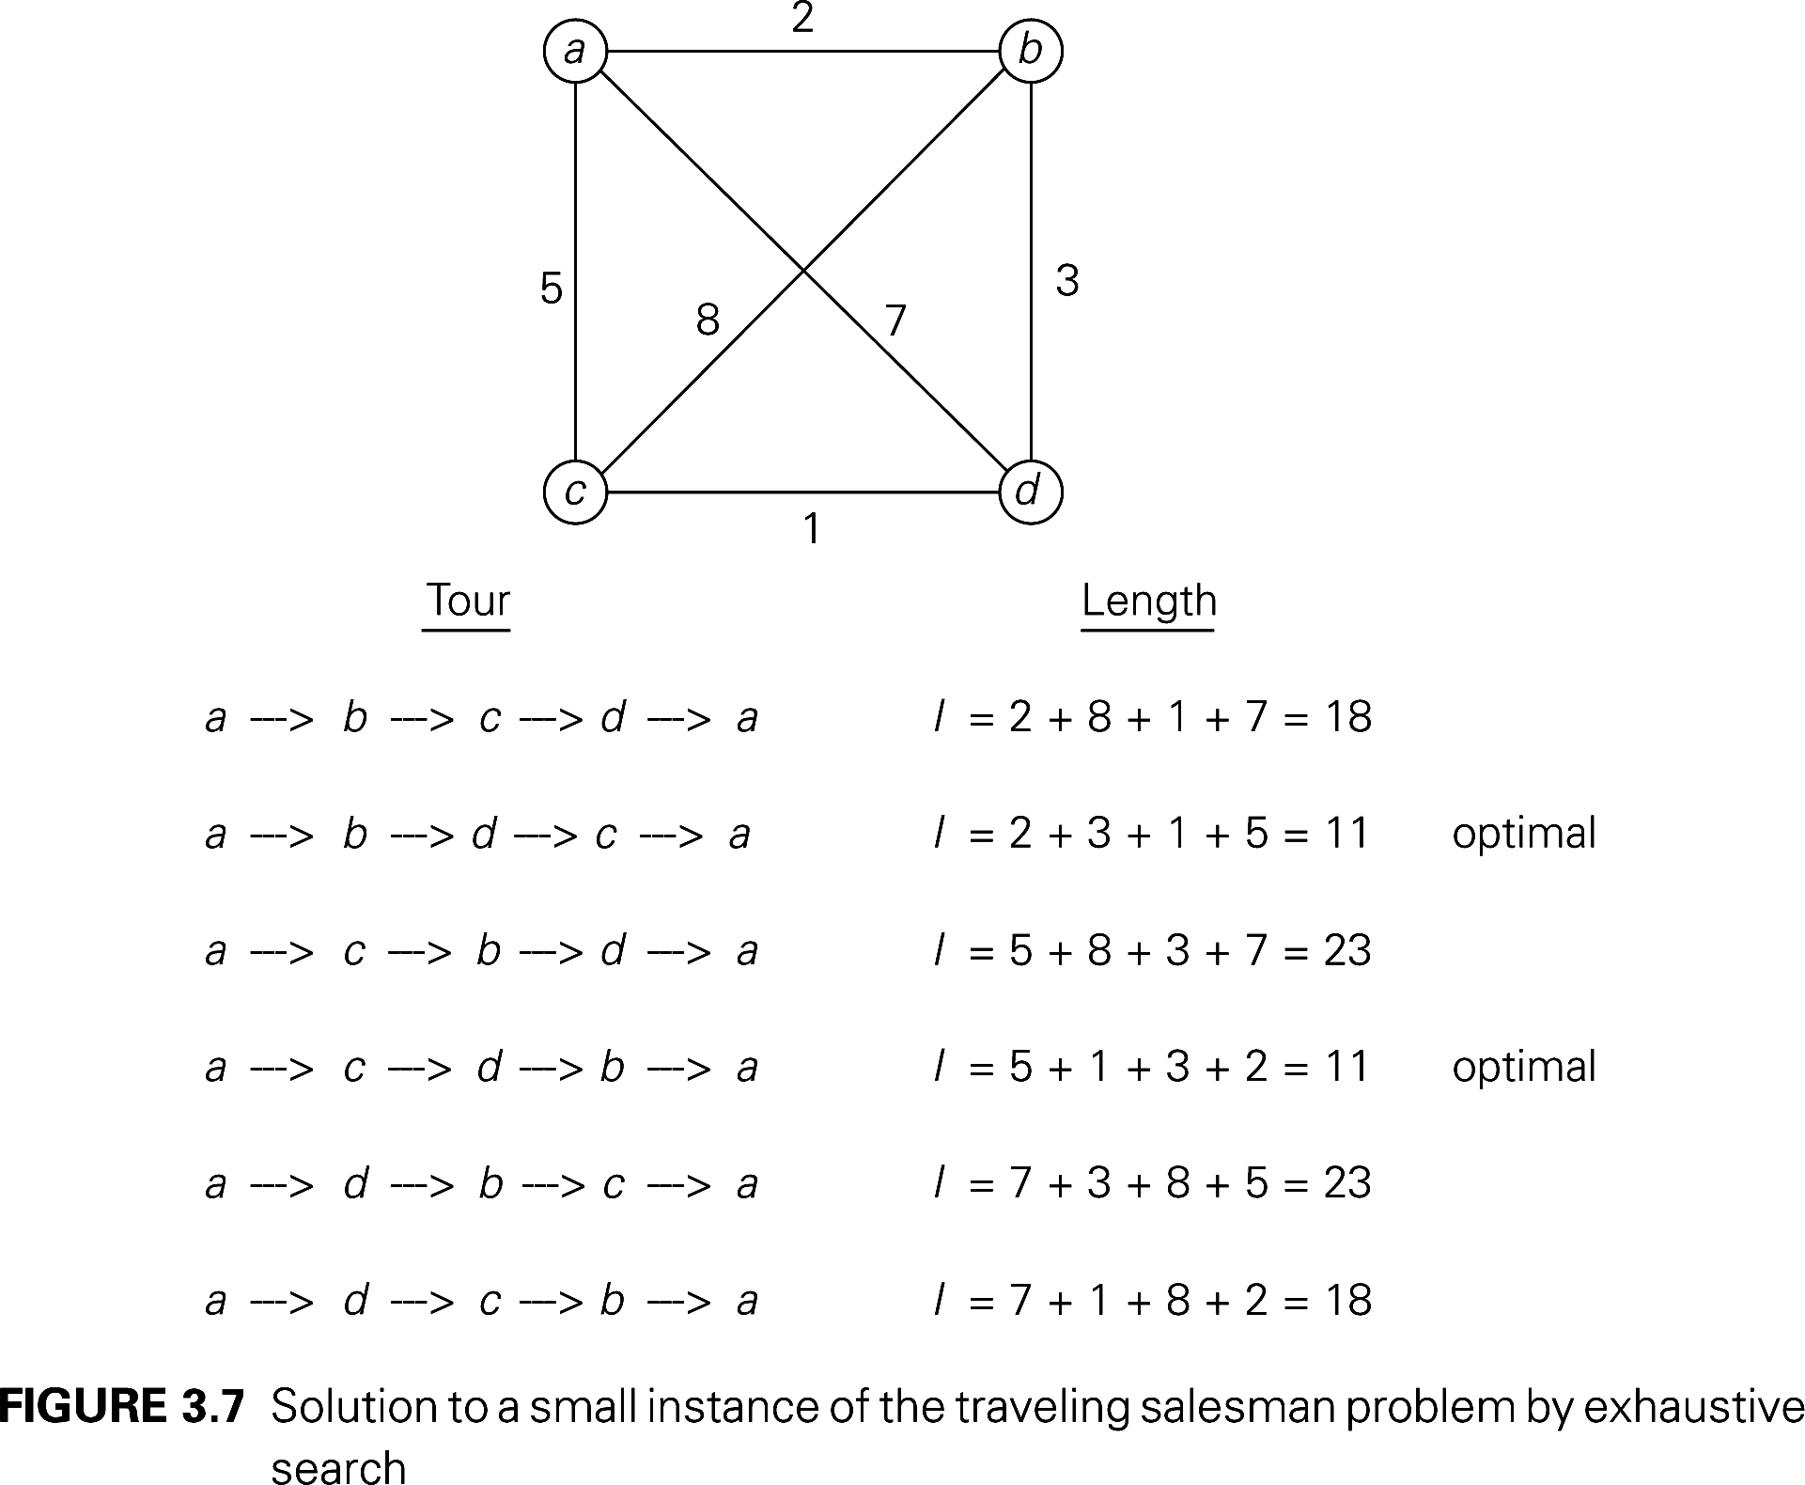

Slide 4
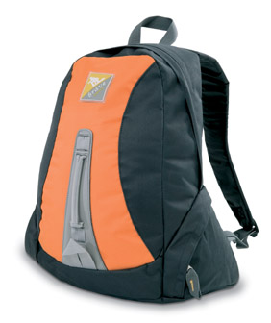
Knapsack Problem

Slide 5
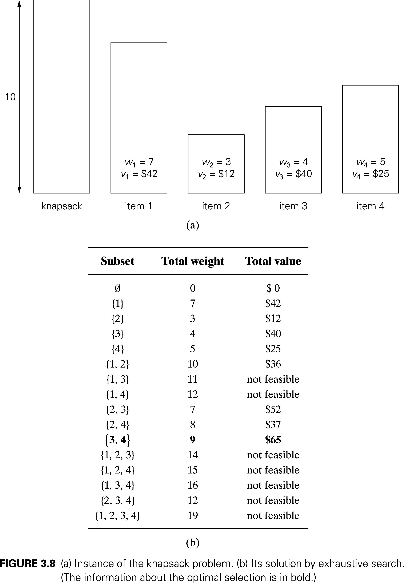

Slide 6
Assignment Problem
 | Job 1 | Job2 | Job 3 | Job 4
Person 1 | 9 | 2 | 7 | 8
Person 2 | 6 | 4 | 3 | 7
Person 3 | 5 | 8 | 1 | 8
Person 4 | 7 | 6 | 9 | 4

Slide 7
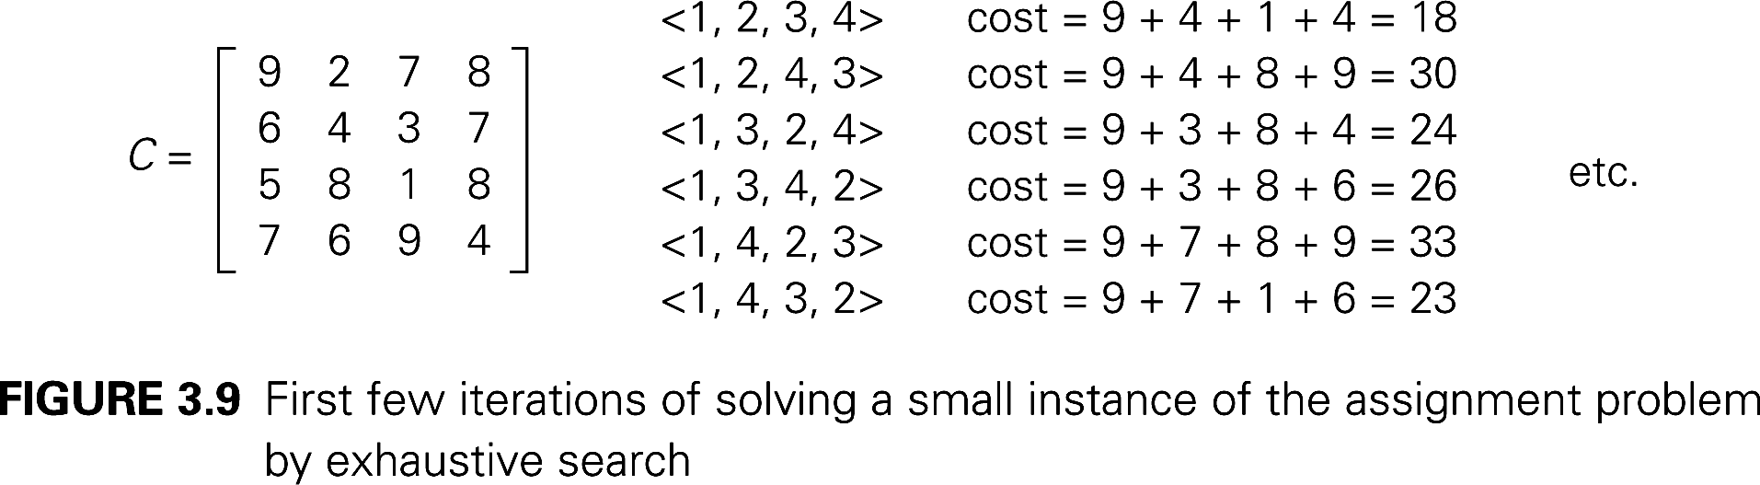

Slide 8
Assignment 1
The Travelling Salesman Problem

